Slide 1













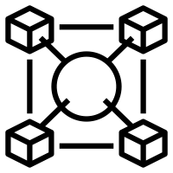

Business Functional
MSIL Project Management Architecture and Design
Process leveraging AI
Ecosystem
E2E Architecture of Project Management Application Platform:
Recommended architectural principles /frameworks, standards
Architectural building blocks
Platform architecture
Integration architecture
Potential technology choices
Deployment Patterns
Key focus of the architectural consulting would be around following dimensions:
Application Availability
Application Reliability
Application Scalability
Stability
Performance
Application Security
Observability and Auto Healing
Deployment/DevSecOps
Innovation & Flexibility
Technology & Tooling
Recommend the Technology framework and Tooling mechanism.
Identify possible innovations/initiatives for bringing more automation and reduce the operational expenditure and faster time to market.
Workflows
Architecture Design Pattern
Headless Architecture
CQRS pattern
Event Driven
Microservices API
Hexagonal Architecture
Layered Architecture – N-Tier
Deployment Patterns
On Prem
Cloud
Hybrid
Non-Functional
Maintainability
Availability
Performance
Security
Scalability
Interoperability
Usability

Slide 2




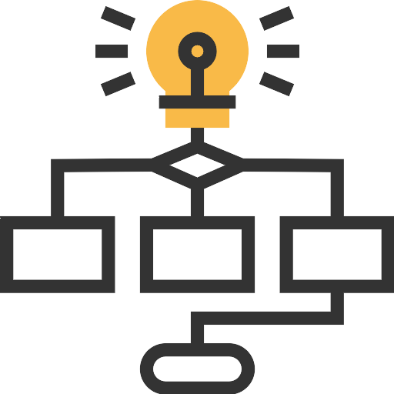


Base project management reference architecture
Client
User
Admin
User
Digital Vendor
AMS Config. Support
App. Config & development.
Assign
Incidents
External AI Tools
Config Deployment
Cloud
Leverage AI services
Incident Management tool
User Interface
Tools
Collect app logs & Server Metrics.
Caching
Monitoring & Automation
UI Interfaces
Compression
Raise Incidents
Deploy Application Package
Client Essential Platforms
(External user/Provisioning)
Business Logic
Ideation
SLA Measurement
DevOps
API / Connectors / Adaptors
API / Connectors / Adaptors
Client user provisioning
Planning
Notifications
Tracking
Task Management
Backup File system and DB
Workflows
Rules
Data Layer
Backup
Client Security & Authentication
Authentication
Endpoint SSO
Security
API Integration
Monitor Endpoint security, Remote access, Vulnerability patch & Health check scans
Client Enterprise Network
(Applications/tools)

